Slide 1

California State University, Northridge
Department of Electrical & Computer Engineering
ECE 526 Project
Avinash Damse(203131064)

Slide 2
AES (Advanced Encryption Standard)
Advanced Encryption Standard (AES) is a specification for the encryption of electronic data .(Plain text, numbers)
AES is a symmetric block cipher chosen by the U.S. government to protect classified information.
Established by the U.S National Institute of Standards and Technology (NIST) in 2001.
AES is widely used today as it is a much stronger than DES and triple DES despite being harder to implement.

Slide 3
AES is a block cipher.
AES-128 AES-192 AES-256
The key size can be 128/192/256 bits.
Encrypts data in blocks of 128 bits each.
Using cryptographic keys of 128, 192 and 256 bits, respectively.
(Secret Key)

Slide 4
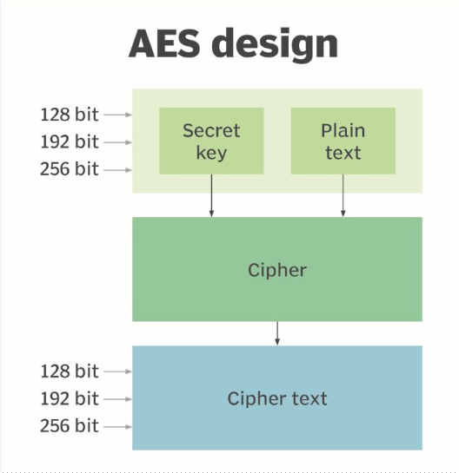

Slide 5
AES-128
It takes 128 bits as input and outputs 128 bits of encrypted cipher text as output.
AES relies on substitution-permutation network principle .
It is performed using a series of linked operations which involves replacing and shuffling of the input data.

Slide 6
Working
Creation of Round Keys.
128 bit key – 10 rounds
192 bit key – 12 rounds
256 bit key – 14 rounds
A Key Schedule algorithm is used to calculate all the round keys from the key.
So the initial key is used to create many different round keys which will be used in the corresponding round of the encryption.

Slide 7
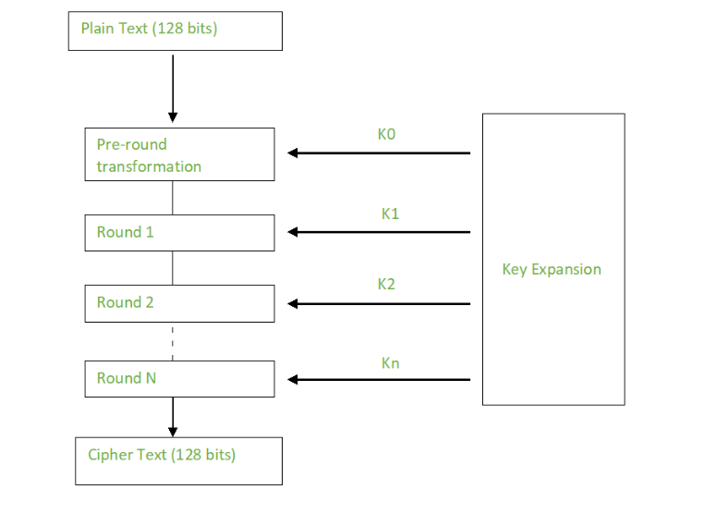

Slide 8
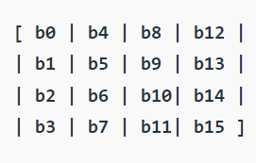
Encryption
AES considers each block as a 16 byte (4 byte x 4 byte = 128 ) grid in a column major arrangement.

Slide 9
Each round comprises of 4 steps :
SubBytes
ShiftRows
MixColumns
Add Round Key

Slide 10
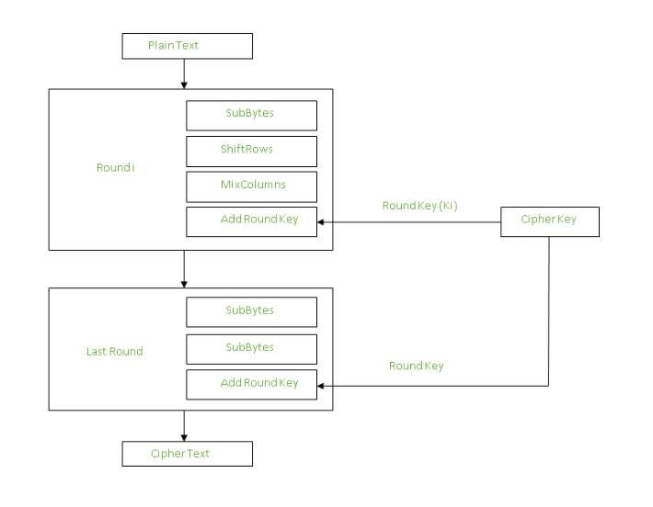

Slide 11
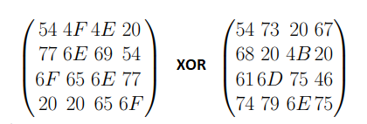
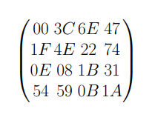
Round 0

Slide 12
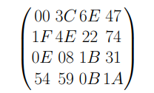
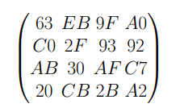
SubBytes
substitute each entry (byte) of current state matrix by corresponding entry in AES S-Box

Slide 13
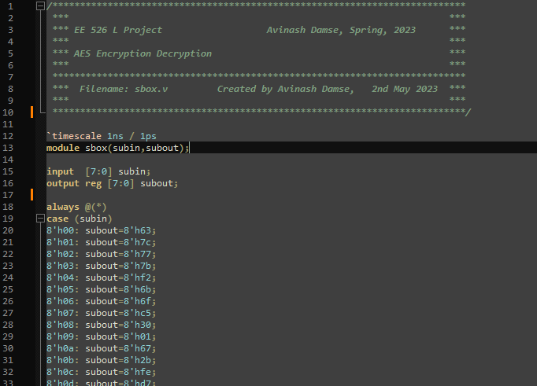

Slide 14
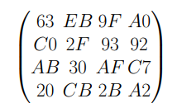
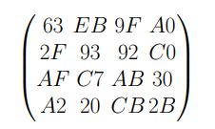
ShiftRows
Four rows are shifted cyclically to the left by offsets of 0,1,2, and 3

Slide 15
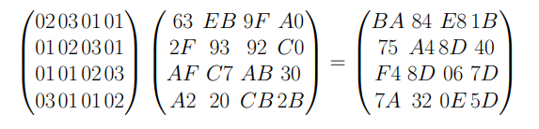
MixColumns
Mix Column multiplies fixed matrix against current State Matrix:

Slide 16
Decryption
The stages of each round in decryption is as follows :
Add round key
Inverse MixColumns
ShiftRows
Inverse SubByte

Slide 17
Test Example
Message :
Text: Five Gm Creatine
Hex : 4669766520476d204372656174696e65
Key : Text : I Love Robots
Hex : 49204c6f766520526f626f7473

Slide 18
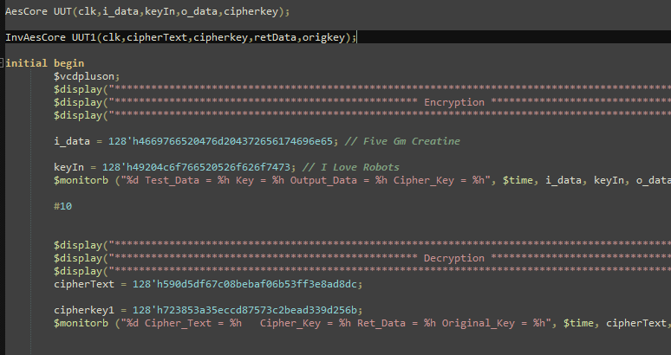

Slide 19
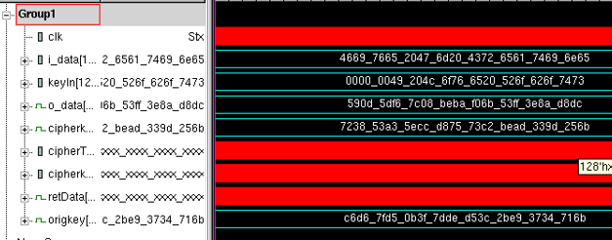

Slide 20
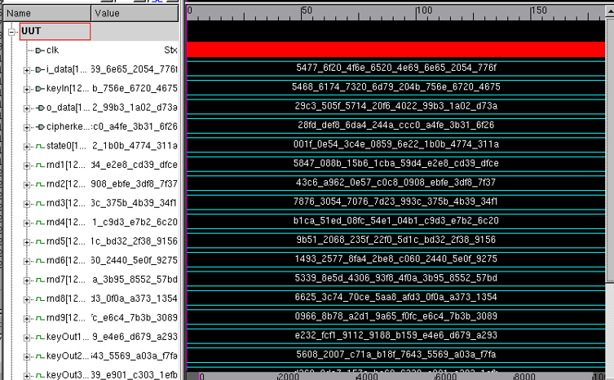

Slide 21
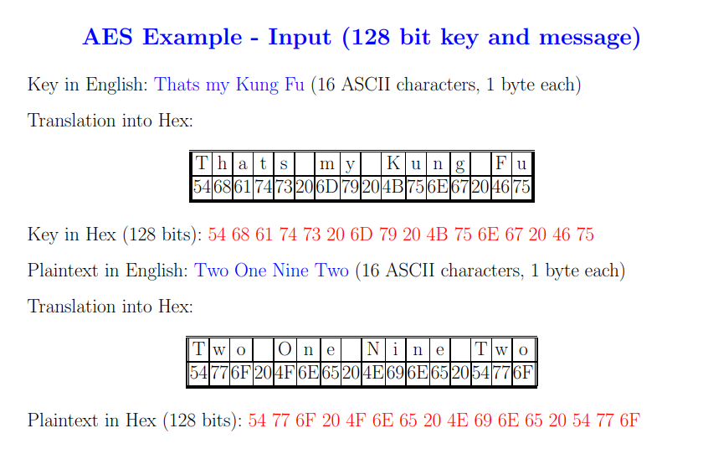


Slide 22
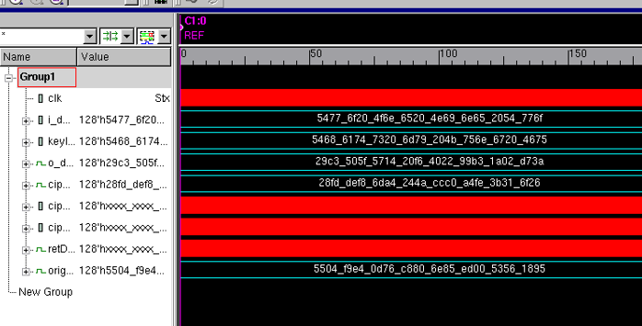

Slide 23
Thank You !!!

